Slide 1
(CUI) Pyshark Live Capture LCSF 17 November 2022
Pyshark Live Capture Application Overview
Front End Operator Interface
Select input(s) DHSYL(1,2), DDD(1,2) and Gyro NAV
Select time duration or number of packets to capture
Select parameter(s) to measure
Back End Operator Interface
Display current measurements
Display number of packets and time elapsed
Display interface errors, timeout, checksum, status

Slide 2
(CUI) CURRENT APPLICATION STATUS 17 November 2022
Pyshark Live Operational
On Cluster : Python Development Virtual Machine
Python version 3.6.8, CentOS 7.5, PyShark 0.4.2.9
DHSYL(1:2), DDD(1:2) or Gyro NAV Inputs
All sensor parameters saved to PCAP and CSV
Delta Time between packets saved
Input Stimulus from Cluster VMS Stim Simulator
VMS, NEIS and NPU Simulators Running
On Python Dev VM Nav_SS Simul Running

Slide 3
(CUI) FEATURES TO BE ADDED
Pyshark Live Additional Features
GUI Front End Operator Interface
Select Sensor, Parameters, Packet Count or Time
Select Output File format : PCAP or CSV
Enter Packet Timeout Value or Use Default, 130 mSec
GUI Back End Operator Interface
Display Current Sensor Measurements
Display Elapsed Time, Number of Packets
Display Errors Detected, Timeout, Checksum, Status
Plot Detected Values over time, MatPlotLib

Slide 4
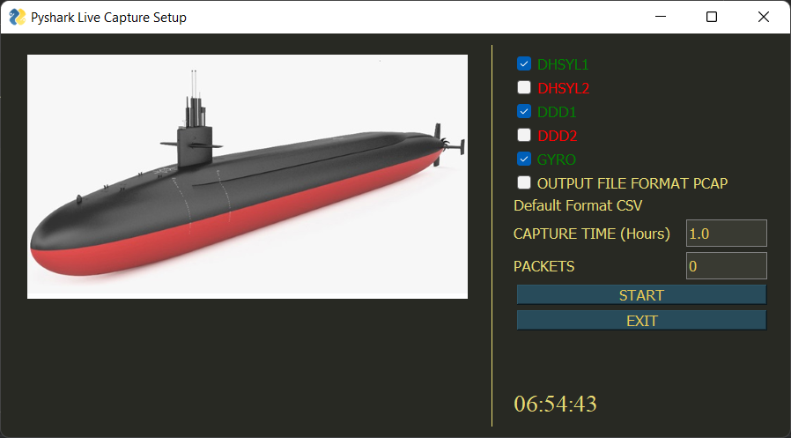
(CUI) FRONT END GUI ILLUSTRATION

Slide 5
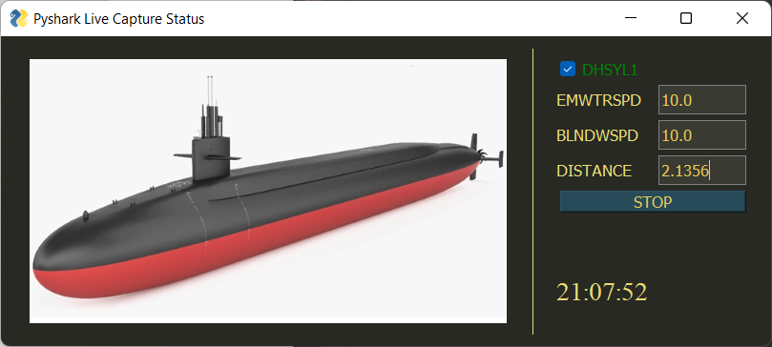
(CUI) BACK END GUI ILLUSTRATION

Slide 6
(CUI) DHSYL CSV Output File
Pyshark Live Additional Features
GUI Front End Operator Interface
Select Sensor, Parameters, Packet Count or Time
Select Output File format : PCAP or CSV
Enter Packet Timeout Value or Use Default, 130 mSec
GUI Back End Operator Interface
Display Current Sensor Measurements
Display Elapsed Time, Number of Packets
Display Errors Detected, Timeout, Checksum, Status
Plot Detected Values over time, MatPlotLib

Slide 7
(CUI) COMPATIBILITY WITH LCSF
Pyshark Built on Wireshark Tshark Applications
Current versions of Pyshark run on Python 3
Legacy versions of Pyshark run on Python 2
Linux Tar Files on Encrypted CD for all LCSF Stations
Goal is for one Utility to run on Python 2 or 3

Slide 8
(CUI) PLANS FOR INITIAL RELEASE
Pyshark Live Capture Version 1.0
Initial release on Cluster Python Dev Virtual Machine, Python3
Link up to selected interfaces through APCON switching
Python 2.7.5 Version, 1.0A
ATRT and other Linux Workstations and VMs

